Slide 1
Homework-Ch1

Slide 2
1-1. Five routers are to be connected in a point-to-point subnet . Between each pair of routers, the designers may put a high-speed line, a medium-speed line, a low-speed line, or no line. If it takes 100 ms of computer time to generate and inspect each topology, how long will it take to inspect all of them?
Call the routers A, B, C, D, and E. There are ten potential lines: AB, AC, AD, AE, BC, BD, BE, CD, CE, and DE. Each of these has four possibilities (three speeds or no line), so the total number of topologies is 4¹⁰ = 1, 048, 576. At 100 ms each, it takes 104,857.6 sec, or slightly more than 29 hours to inspect them all.

Slide 3
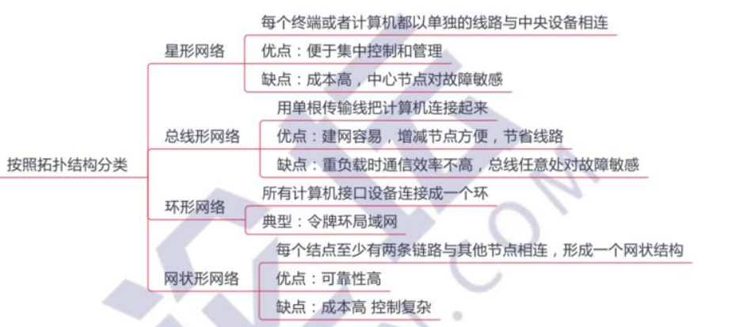

Slide 4
1-2. What are two reasons for using layered protocols? What is one possible disadvantage of using layered protocols?
Among other reasons for using layered protocols, using them leads to breaking up the design problem into smaller, more manageable pieces, and layering means that protocols can be changed without affecting higher or lower ones.
One possible disadvantage is the performance of a layered system is likely to be worse than the performance of a monolithic system, although it is extremely difficult to implement and manage a monolithic system.
Advantages
Modularity
Abstraction
Reuse
Disadvantages
Information hiding
Inefficient implementations

Slide 5
1-3. What is the principal difference between connectionless communication and connection-oriented communication? Give one example of a protocol that uses (i) connectionless communication (ii) connection-oriented communication
Three phases VS. sending data directly
The order of the data is not guaranteed or not.
Connection-oriented communication has three phases. In the establishment phase a request is made to set up a connection. Only after this phase has been successfully completed can the data transfer phase be started and data transported. Then comes the release phase. In most cases the order is preserved so that the bits arrive in the order they were sent.
Connectionless communication does not have these phases. It just sends the data. The order of the data is not guaranteed.

Slide 6
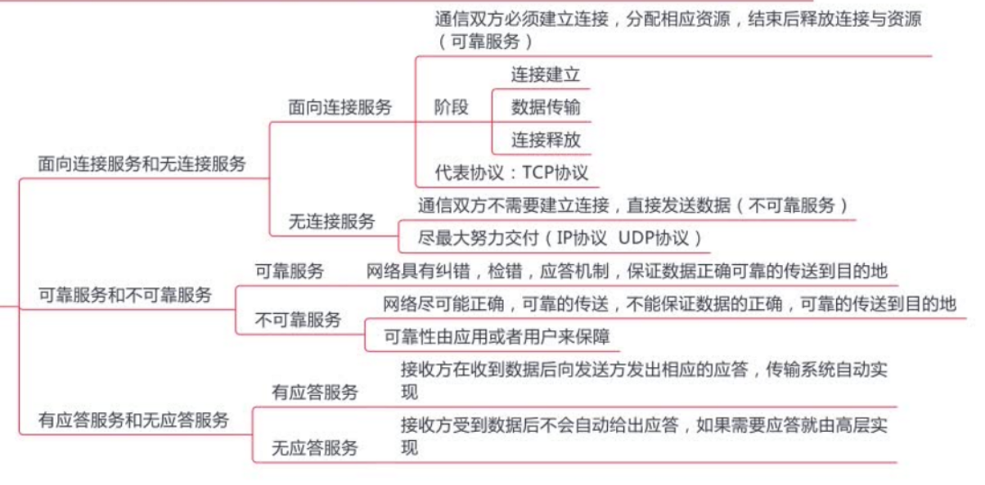

Slide 7
1-4. In some networks, the data link layer handles transmission errors by requesting that damaged frames be retransmitted. If the probability of a frame's being damaged is p, what is the mean number of transmissions required to send a frame? Assume that acknowledgements are never lost.
The probability, P_{k}, of a frame requiring exactly k transmissions is the probability of the first k - 1 attempts failing, p^{k - 1}, times the probability of the k-th transmission succeeding, (1 - p).
The mean number of transmission is then just
Or, more directly, if the probability of a message getting through is 1 - p then the expected number of transmissions per successful message is 1 / ( 1 - p ).

Slide 8
1-5. A system has an n-layer protocol hierarchy. Applications generate messages of length M bytes. At each of the layers, an h-byte header is added. What fraction of the network bandwidth is filled with headers?
With n layers and h bytes added per layer, the total number of header bytes per message is hn, so the space wasted on headers is hn.
The total message size is M + nh, so the fraction of bandwidth wasted on headers is hn/(M + hn).
This estimate does not take into account fragmentation (one higher layer message is sent as multiple lower layer messages) or aggregation (multiple higher layer messages are carried as one lower layer message) that may be present. If fragmentation is used, it will raise the overhead. If aggregation is used, it will lower the overhead.

Slide 9
1-6. What is the main difference between TCP and UDP?
TCP is connection oriented, whereas UDP is a connectionless service.
Alternatively, TCP provides a reliable service, whereas UDP provides an unreliable service.

Slide 10
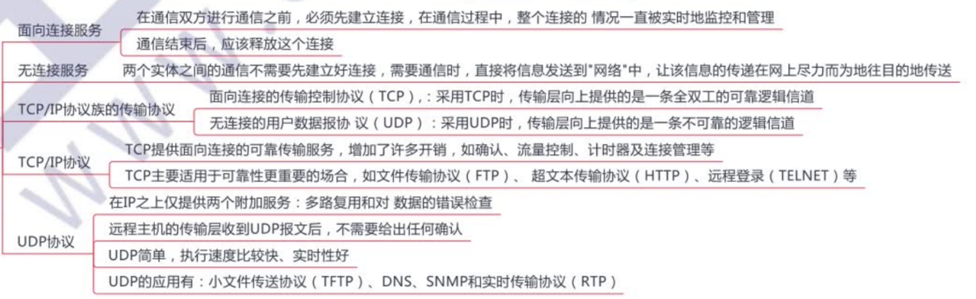

Slide 11
1-7. When a file is transferred between two computers, two acknowledgement strategies are possible. In the first one, the file is chopped up into packets, which are individually acknowledged by the receiver, but the file transfer as a whole is not acknowledged. In the second one, the packets are not acknowledged individually, but the entire file is acknowledged when it arrives. Discuss these two approaches.
If the network tends to lose packets, it is better to acknowledge each one separately, so the lost packets can be retransmitted.
On the other hand, if the network is highly reliable, sending one acknowledgement at the end of the entire transfer saves bandwidth in the normal case (but requires the entire file to be retransmitted if even a single packet is lost).

Slide 12
1-8. An image is 1024 X 768 pixels with 3 bytes/pixel. Assume the image is uncompressed. How long does it take to transmit it over a 56-kbps modem channel? Over a 1-Mbps cable modem? Over a 10-Mbps Ethernet? Over 100-Mbps Ethernet? Over gigabit Ethernet?
（单位问题，进制问题）
The image is 1024 X 768 X 3 bytes or 2359296 bytes. This is 18874368 bits.
At 56,000 bits/sec, it takes about 337.042sec.
At 1,000,000 bits/sec, it takes 18.874 sec.
At 10,000,000 bits/sec, it takes 1.887 sec.
At 100,000,000 bits/sec, it takes about 0.189 sec.
At 1,000,000,000 bits/sec it takes about 19 msec.

Slide 13
1-9. Suppose the algorithms used to implement the operations at layer k is changed. How does this impact operations at layers k − 1 and k + 1?
This has no impact on the operations at layers k-1 or k+1.

Slide 14
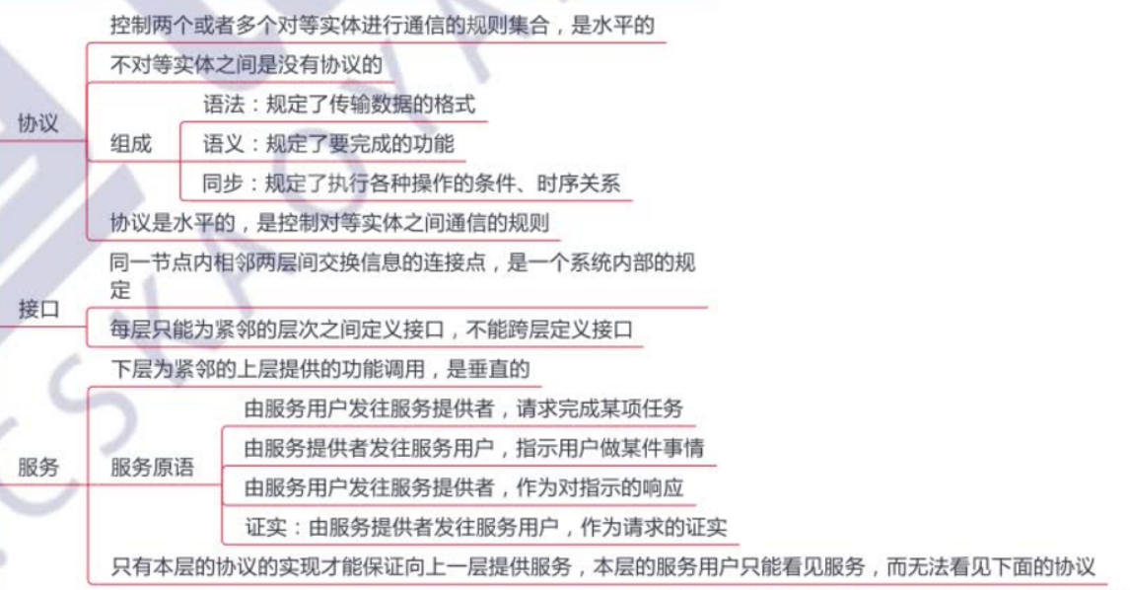

Slide 15
1-10. Suppose there is a change in the service (set of operations) provided by layer k. How does this impact services at layers k-1 and k+1?
There is no impact at layer k-1, but operations in k+1 have to be reimplemented.

Slide 16
Homework-Ch2

Slide 17
2-1. A noiseless 8-kHz channel is sampled every 1 msec. What is the maximum data rate? A noiseless channel can carry an arbitrarily large amount of information, no matter how often it is sampled. Just send a lot of data per sample.
For the 8-kHz channel, make 16000 samples/sec. If each sample is 16 bits, the channel can send 256 kbps. If each sample is 1024 bits, the channel can send 16.384 Mbps. The key word here is ‘‘noiseless.’’

Slide 18
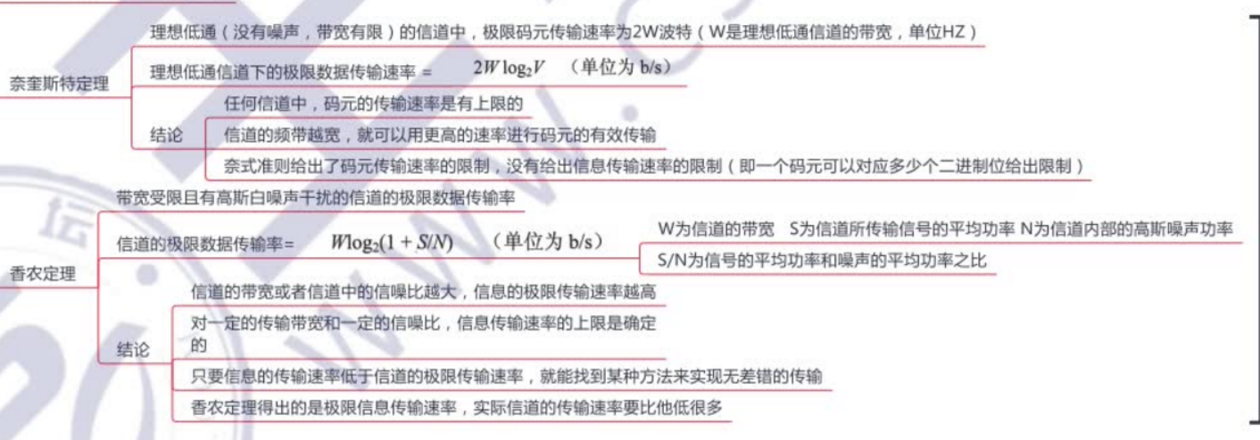
无噪声信道码元传输的极限速率是有限的，但每个码元可以携带的数据量是无限的，因此总体无上限。
但在本题中我的理解是认为需要和采样速率进行比较。

Slide 19
2-2. If a binary signal is sent over a 3-kHz channel whose signal-to-noise ratio is 20 dB, what is the maximum achievable data rate?
A signal-to-noise ratio of 20 dB means S/N = 100. Since log₂ 101 is about 6.658, the Shannon limit is about 19.975 kbps.
The Nyquist limit is 6 kbps for a binary signal (with 1 bit per symbol).
The bottleneck is therefore the Nyquist limit, giving a maximum channel capacity of 6 kbps.

Slide 20
2-3. How much bandwidth is there in 0.1 microns of spectrum at a wavelength of 1 micron?
Δf = Δλ × c / λ² = 0.1 × 10 ⁻⁶ ×3 × 10⁸ / (10⁻⁶)² = 3 × 10¹³ = 30,000 GHz
OR Use Eq. (2-4) to convert wavelengths of 1 micron plus/minus 0.05 microns to frequency.
We have f_{low} = 3 × 10⁸ / (1. 05 × 10⁻⁶ ) = 3/1. 05 × 10¹⁴. Similarly f_{high} = 3/0. 95 × 10¹⁴.
Thus Δf = (3/0. 95 - 3/1. 05) × 10¹⁴ = 3 × 10¹³. This is a bandwidth of 30,000 GHz.

Slide 21
2-4. It is desired to send a sequence of computer screen images over an optical fiber. The screen is 1920x1200 pixels, each pixel being 24 bits. There are 50 screen images per second. How much bandwidth is needed and how many microns of wavelength are needed for this band at 1.30 microns?
The data rate is 2560 ×1600 ×24 ×60 bps, which is 5898 Mbps. For simplicity, let us assume 1 bps per Hz, so that we require roughly 6 ×10⁹ MHz of bandwidth.
Δf = Δλ × c / λ² , 6 ×10⁹ = Δλ × 3 × 10⁸ / (1.3 × 10⁻⁶)² , Δλ = 3. 38 ×10⁻⁵ microns.
OR From Eq. (2-4) we can convert wavelengths to bandwidth. Let the wavelengths range from 1.3 microns to 1. 3 + l microns. Then with Eq. (2-4) we have: 3 ×10⁸/1. 3 ×10⁻⁶- 3 ×10⁸ / [ (1. 3 + l ) ×10⁻⁶ ] = 6 ×10⁹. Solving, l = 3. 3 ×10⁻⁵ microns. The range of wavelengths used is very short, even with slightly different assumptions.

Slide 22
2-5. Radio antennas often work best when the diameter of the antenna is equal to the wavelength of the radio wave. Reasonable antennas range from 1 cm to 5 meters in diameter. What frequency range does this cover?
Start with λf = c. We know that c is 3 ×10⁸ m/s. For λ = 1 cm, we get 30 GHz.
For λ = 5 m, we get 60 MHz.
Thus, the band covered is 60 MHz to 30 GHz.

Slide 23
2-6. Ten signals, each requiring 4000 Hz, are multiplexed onto a single channel using FDM. What is the minimum bandwidth required for the multiplexed channel? Assume that the guard bands are 400 Hz wide.
There are 10 4000 Hz signals. We need nine guard bands to avoid any interference. The minimum bandwidth required is 4000 ×10 + 400 ×9 = 43, 600 Hz.

Slide 24
2-7. Why has the PCM sampling time been set at 125 μsec?
A sampling time of 125 m sec corresponds to 8000 samples per second.
According to the Nyquist theorem, this is the sampling frequency needed to capture all the information in a 4-kHz channel, such as a telephone channel. (Actually the nominal bandwidth is less, but the cutoff is not sharp.)

Slide 25
2-8. Compare the maximum data rate of a noiseless 4-kHz channel using (a) Analog encoding (e.g., QPSK) with 2 bits per sample. (b) The T1 PCM system.
In both cases 8000 samples/sec are possible.
With QPSK encoding, 2 bits are sent per sample. With modern T1, 8 bits are sent per period. (With older T1s only 7 of the 8 bits could be used for data.)
The respective data rates are 16 kbps and 64 kbps.

Slide 26
2-9. A CDMA receiver gets the following chips: (-1 +1 -3 +1 -1 -3 +1 +1). Assuming the chip sequences defined in Fig. 2-28(a), which stations transmitted, and which bits did each one send?
Just compute the four normalized inner products:
(-1 +1 -3 +1 -1 -3 +1 +1) • (-1 -1 -1 +1 +1 -1 +1 +1)/8 = 1
(-1 +1 -3 +1 -1 -3 +1 +1) • (-1 -1 +1 -1 +1 +1 +1 -1)/8 = -1
(-1 +1 -3 +1 -1 -3 +1 +1) • (-1 +1 -1 +1 +1 +1 -1 -1)/8 = 0
(-1 +1 -3 +1 -1 -3 +1 +1) • (-1 +1 -1 -1 -1 -1 +1 -1)/8 = 1
The result is that A and D sent 1 bits, B sent a 0 bit, and C was silent.

Slide 27
2-10. A cable company decides to provide Internet access over cable in a neighborhood consisting of 5000 houses. The company uses a coaxial cable and spectrum allocation allowing 100 Mbps downstream bandwidth per cable. To attract customers, the company decides to guarantee at least 2 Mbps downstream bandwidth to each house at any time. Describe what the cable company needs to do to provide this guarantee.
A 2-Mbps downstream bandwidth guarantee to each house implies at most 50 houses per coaxial cable.
Thus, the cable company will need to split up the existing cable into 100 coaxial cables and connect each of them directly to a fiber node.

Slide 28
Homework-Ch3

Slide 29
3-1. The following data fragment occurs in the middle of a data stream for which the byte stuffing algorithm described in the text is used: A B ESC C ESC FLAG FLAG D. What is the output after stuffing?
After stuffing, we get A B ESC ESC C ESC ESC ESC FLAG ESC FLAG D.

Slide 30
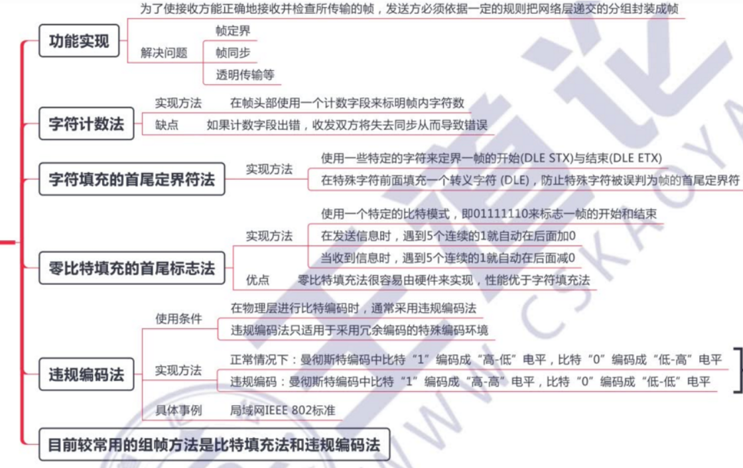

Slide 31
3-2. Can you think of any circumstances under which an open-loop protocol (e.g., a Hamming code) might be preferable to the feedback-type protocols discussed throughout this chapter?
If the propagation delay is very long, as in the case of a space probe on or near Mars or Venus, forward error correction is indicated.
It is also appropriate in a military situation in which the receiver does not want to disclose its location by transmitting.
If the error rate is low enough that an error-correcting code is good enough, it may also be simpler.
Finally, real-time systems cannot tolerate waiting for retransmissions.

Slide 32
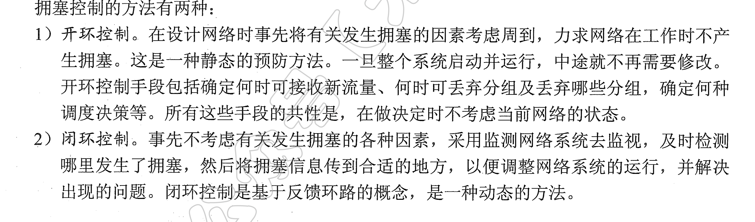

Slide 33
3-3. An 8-bit byte with binary value 10101111 is to be encoded using an even-parity Hamming code. What is the binary value after encoding?
编号从左至右递增：
The encoded value is 101001001111.
编号从右向左递增：
The encoded value is 101001110101

Slide 34
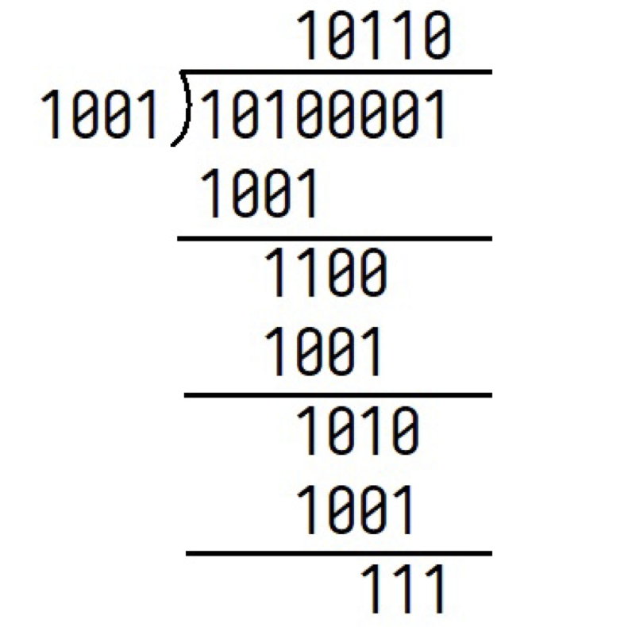
3-4. What is the remainder obtained by dividing x⁷ + x⁵ +1by the generator polynomial x³+1?
The remainder
is x² + x + 1.

Slide 35
3-5. Suppose that a message 1001 1100 1010 0011 is transmitted using Internet Checksum (4-bit word). What is the value of the checksum?
To obtain the checksum, we need to calculate the ones complement of the ones complement sum of the words. The ones complement sum is same as sum modulo 2⁴ and adding any overflow of high order bits back into low-order bits:
0011 + 1010 = 1101
1101 + 1100 = 1001 + 1 = 1010
1010 + 1001 = 0011 + 1 = 0100.
So, the Internet checksum is the ones complemnet of 0100, or 1011.

Slide 36
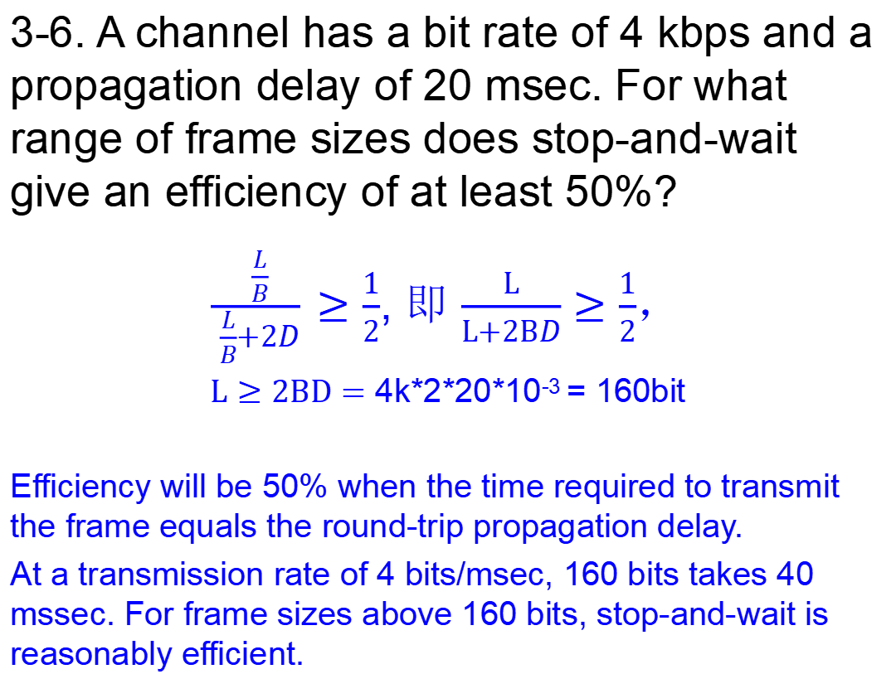
3-6. A channel has a bit rate of 4 kbps and a propagation delay of 20 msec. For what range of frame sizes does stop-and-wait give an efficiency of at least 50%?
$\frac{\frac{L}{B}}{\frac{L}{B}+2D}≥\frac{1}{2}$, 即 $\frac{L}{L+2BD}≥\frac{1}{2}$，
$L≥2BD=$ 4k*2*20*10⁻³ = 160bit
Efficiency will be 50% when the time required to transmit the frame equals the round-trip propagation delay.
At a transmission rate of 4 bits/msec, 160 bits takes 40 mssec. For frame sizes above 160 bits, stop-and-wait is reasonably efficient.

Slide 37
3-7. A 3000-km-long T1 trunk is used to transmit 64-byte frames using protocol 5. If the propagation speed is 6 μsec/km, how many bits should the sequence numbers be?
To operate efficiently, the sequence space (actually, the sender’s window size) must be large enough to allow the transmitter to keep transmitting until the first acknowledgement has been received.
The propagation time is 18 ms.
At T1 speed, which is 1.536 Mbps (excluding the 1 header bit), a 64-byte frame takes 0.300 msec.
Therefore, the first frame fully arrives 18.3 msec after its transmission was started.
The acknowledgement takes another 18 msec to get back, plus a small (negligible) time for the acknowledgement to arrive fully.
In all, this time is 36.3 msec, so the transmitter needs to have enough window space to keep going for 36.3 msec.
A frame takes 0.3 ms, so it takes 121 frames to fill the pipe.
Seven-bit sequence numbers are needed.

Slide 38
3-8. In protocol 6, when a data frame arrives, a check is made to see if the sequence number differs from the one expected and no nak is true. If both conditions hold, a NAK is sent. Otherwise, the auxiliary timer is started. Suppose that the else clause were omitted. Would this change affect the protocol’s correctness?
Yes. It might lead to deadlock.
Suppose that a batch of frames arrived correctly and was accepted. The receiver would advance its window.
Now suppose that all the acknowledgements were lost. The sender would eventually time out and send the first frame again. The receiver would then send a NAK.
If this packet were lost, from that point on, the sender would keep timing out and sending a frame that had already been accepted, but the receiver would just ignore it.
Setting the auxiliary timer results in a correct acknowledgement being sent back eventually instead, which resynchronizes.

Slide 39
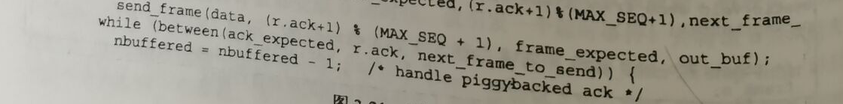
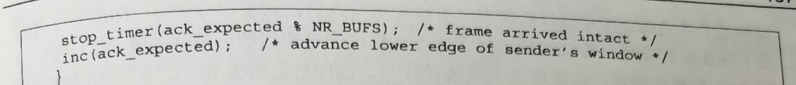
3-9. Suppose that the three-statement while loop near the end of protocol 6 was removed from the code. Would this affect the correctness of the protocol or just the performance? Explain your answer.

Slide 40
3-9. Suppose that the three-statement while loop near the end of protocol 6 was removed from the code. Would this affect the correctness of the protocol or just the performance? Explain your answer.
It would lead to deadlock because this is the only place that incoming acknowledgements are processed. Without this code, the sender would keep timing out and never make any progress.

Slide 41
3-10. Frames of 1000 bits are sent over a 1-Mbps channel using a geostationary satellite whose propagation time from the earth is 270 msec. Acknowledgements are always piggybacked onto data frames. The headers are very short. Three-bit sequence numbers are used. What is the maximum achievable channel utilization for
(a) Stop-and-wait?
(b) Protocol 5?
(c) Protocol 6?
Let t = 0 denote the start of transmission.
At t = 1 msec, the first frame has been fully transmitted.
At t = 271 msec, the first frame has fully arrived.
At t = 272 msec, the frame acknowledging the first one has been fully sent.
At t = 542 msec, the acknowledgement-bearing frame has fully arrived.
Thus, the cycle is 542 msec. A total of k frames are sent in 542 msec, for an efficiency of k/542. Hence, for
(a) k = 1, efficiency = 1/542 = 0.18%.
(b) k = 7, efficiency = 7/542 = 1.29%.
(c) k = 4, efficiency = 4/542 = 0.74%.

Slide 42
End

